Slide 1
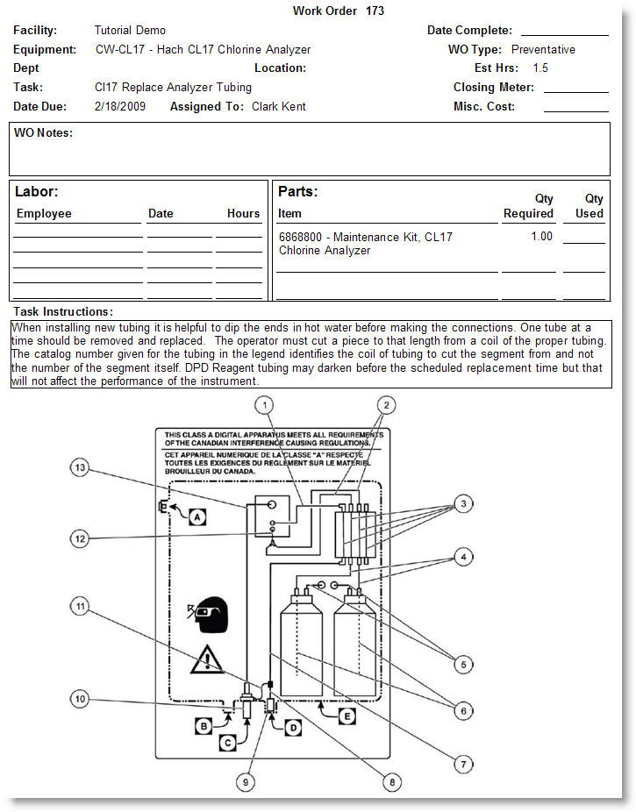
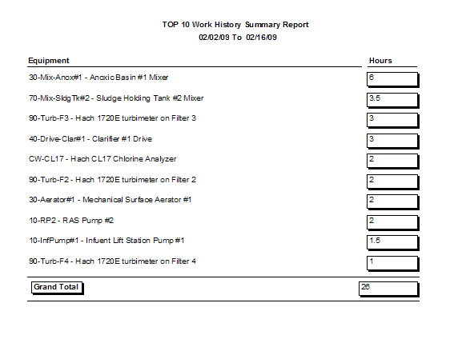
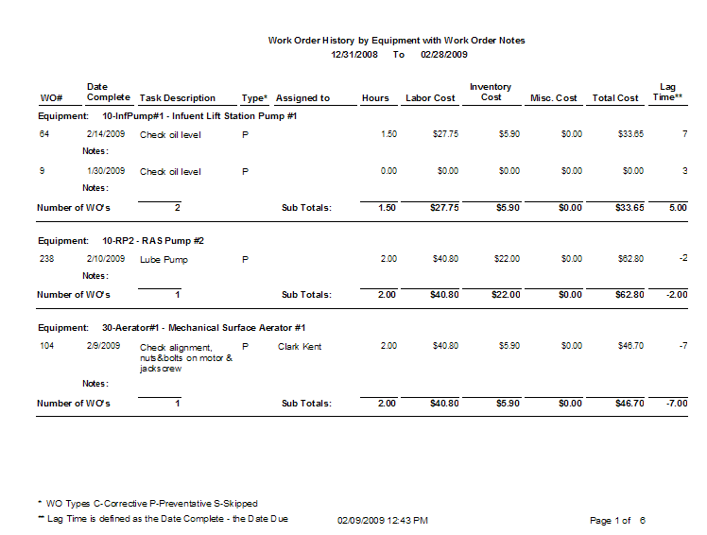
Example JOB Cal Plus Reports

Slide 2
Work Order with Graphics

Slide 3
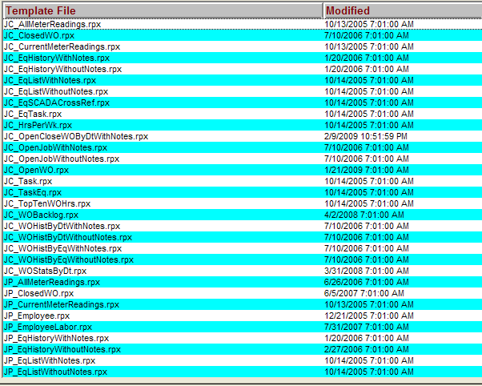
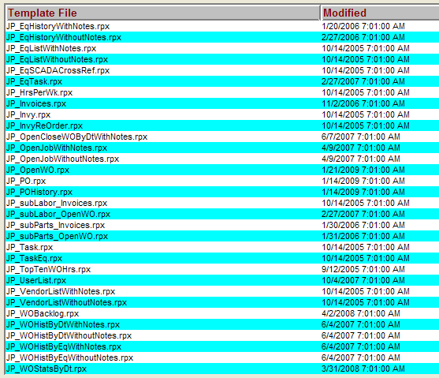
Available Report Templates in JOB Cal Plus

Slide 4
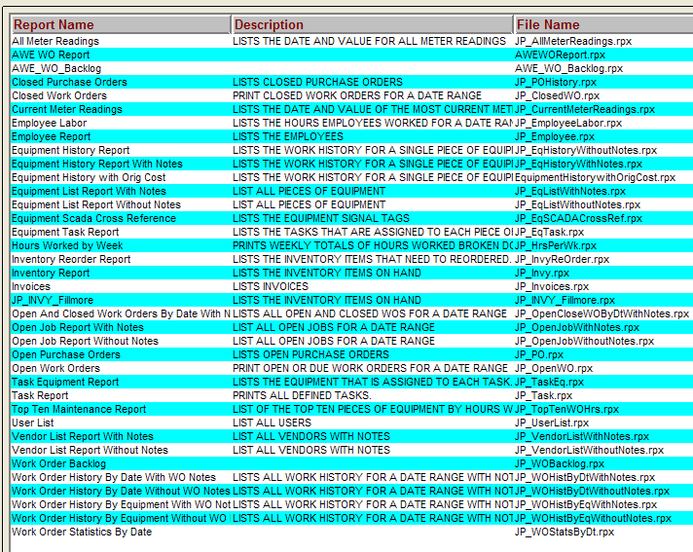
Example Reports in JOB Cal Plus
Additional Custom Reports can be developed by the Hach Services team

Slide 5
Top 10 Work History - Equipment that is using the most time

Slide 6
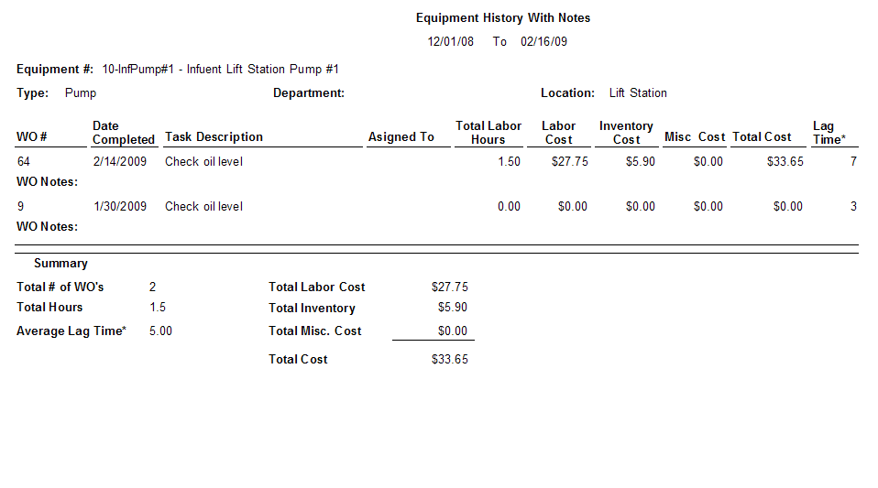
Equipment History Report Example

Slide 7
Work Order History by Equipment Example – page 1

Slide 8
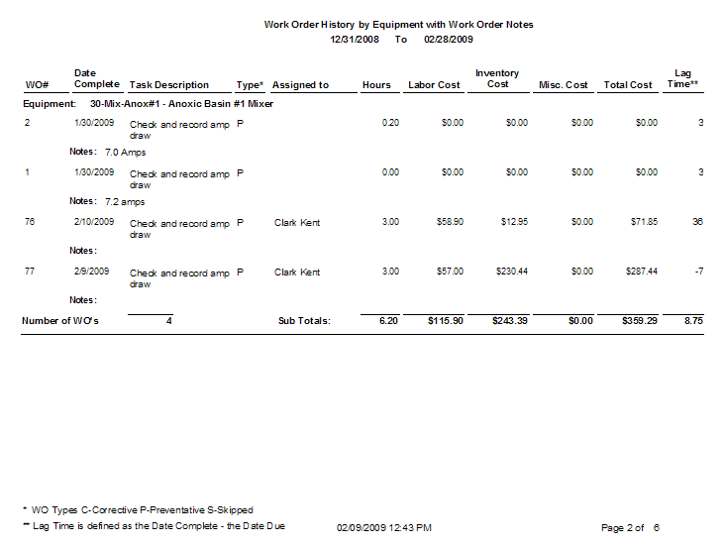
Work Order History by Equipment Example – page 2

Slide 9
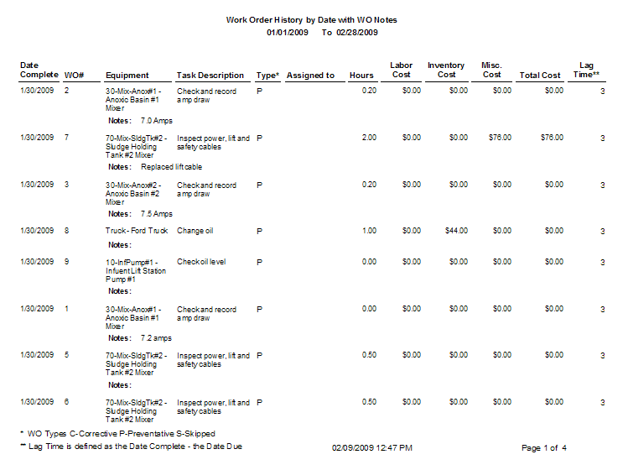
Work Order History by Date Example

Slide 10
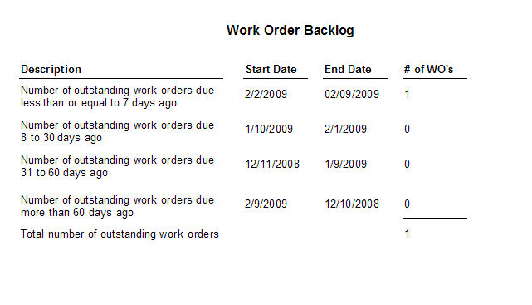

Slide 11
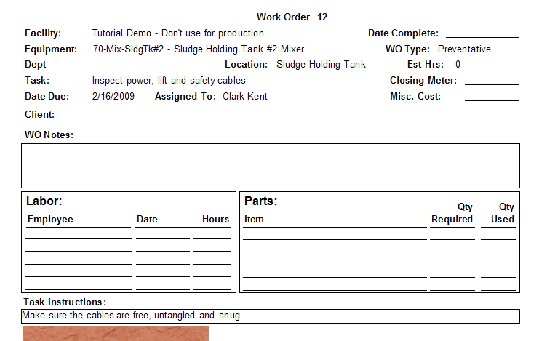
Open Work Order Report

Slide 12
